Slide 1
Chapter two Conceptual Modeling
Wuman Luo, Amy
luowuman@ipm.edu.mo Office: A323 14:30-17:30 Tuesday & Thursday

Slide 2
Outline
A. Requirement Analysis
Identifying fact (with measures) and dimensions (with levels) from typical analysis workload and reports
B. Basics of Conceptual modeling
Notation
Granularity, functional dependency between dim attr, others…
Case study: data-driven
C. Temporal Nature and Aggregation
Transactional vs. snapshot facts
Event, aggregation, additivity of measures
Calculated measures

Slide 3
Part A. Requirement Analysis
Difficulties in user requirement analysis
Multidimensional model
Dimensional nature of business data
Fact, dimension, measure, hierarchies
Identifying Facts and Workload
Studying existing reports
User requirements as typical analysis query workload
Keywords: 'by', 'for'
Identifying facts with conformed dimensions
User Requirement Glossary
Notes:
Read Chap 4 in Rizzi, Chap 5 in Ponniah

Slide 4
Design Methodology
Analysis and Reconciliation
Requirement analysis
Reconciled schema, mapping with data sources
User
requirements
Reconciled schema
Conceptual Design
Workload refinement
metadata
Fact schema
Reconciled schema
Workload, data volume
Logical schema
Logical Design
Staging Design
Logical schema
ETL procedures
Physical Design
Physical schema

Slide 5
Requirement Analysis
Collect end user needs for data mart applications and usage
"What information is needed by users in decision making?"
"Are the information available in operational databases?"
Model the information needs of end users using the multidimensional data model:
Identify Facts, Measures, Dimensions
Significant because it influences many things:
Conceptual design, logical design, physical design
Data-staging design

Slide 6
Difficulties
Data warehousing is a long term project. Difficult to get and arrange every requirement from the beginning
Requirements may be difficult to explain because decision-making processes ..
have very flexible structures,
are poorly shared across large organizations,
are guarded with care by managers, and
may greatly vary as time goes by to keep up with new business process evolution.

Slide 7
Typical decision-making queries
How much did my new product generate
month by month, in the southern division, by customer demographic, by sales office, relative to the previous version, and compared to plan?
The marketing vice president wants the revenue numbers broken down by month, division, customer demographics, sales office, product version, and plan.
Give me sales statistics
by products, summarized by product categories, daily, weekly, and
monthly, by sale districts, by distribution channels.
The marketing manager wants sales statistics (e.g. sold quantity, receipts) of products, broken down by product categories, time (day, week, month), sale districts and distribution channels.

Slide 8
Modeling Business Measurements
"What are the gross margins by product category for January?"
"Show me the trend of monthly sales receipts for 'soft drinks' last year."
To answer these queries, we need to make measurements of 'Sales' business process.
Two measures 'gross margin' and 'receipts' in the fact 'Sales'
Measurement is only meaningful given some context. E.g. the sales receipts of 'text books' in 'Jan 2013' is $23000
Dimensions are date (month, year), product (product category)
Also used to filter, sort, and group measures

Slide 9
Exercise
What are the facts, measures and dimensions in the following queries?
"What are the gross margins by product category for January?"
"What is the average account balance by education level?"
"How many sick days were taken by marketing employees last year?"
"What is the return rate by supplier?"
Notes:
Business processes involve: sales, account management, attendance, return processing

Slide 10
Characteristics of Analysis Queries
Decision-making queries usually involve
Analysis along one or more dimension, e.g. "What are the daily receipts per store?"
Aggregation / summary of numerical data from a large amount of data, e.g. "What is the total amount of receipts recorded last year per city and per product category?"
It is not intuitive to represent multidimensional data in a 2D data model like the relational model
Give me sales statistics
by products, summarized by product categories, daily, weekly, and monthly, and by store location.

Slide 11
Multidimensional model
The multidimensional model represents business data in multidimensional cubes
Example: A cube for the fact Sales, with dimensions Date, Product, Store, and measures quantity and receipts
Notice that some cells in the cube are empty. This cube is sparse.
In general, the 'cube' may have >3 dimensions
Store
Dimensions | Date | 1/13/2012
 | Store | EverMore
 | Product | Coca cola
Measures | quantity | 2
 | receipts | $8.00
Product
An event in the Sales fact
Date

Slide 12
Concepts
Facts are concepts on which end users base their decision-making process. Facts refer to a category of events taking place in the business.
E.g. sales, shipments, hospital admissions, surgeries
Instances of a fact correspond to events that occurred.
E.g. every single sale or shipment carried out is an event
Each fact is described by the values of a set of relevant measures that provide a quantitative description of events.
E.g. sales receipts, amounts shipped, hospital admission costs, and surgery time
The large number of events may be selected and sorted out by different dimensions.
E.g. Sales in a store chain can be represented in a 3D space whose dimensions are products, stores (geography), and dates (time).

Slide 13
Examples: Facts and Dimensions
Business | Facts | Dimensions
Supermarket Chain | Sales | Time, Product, Store, Promotion
Insurance Business | Claims | Time, Claim, Insured Party, Policy, Status, Agent
Manufacturing Company | Shipments | Time, Product, Cust ship-to, Ship from, Ship mode, Deal
Airlines Company | Frequent Flyer Flights | Time, Customer, Flight, Fare class, Airport, Status
Example: one would like to analyze claims data by agent, individual claim, time, insured party, individual policy, and status of the claim
Time is a common dimension
Business dimensions are different and relevant to the industry and to the subject for analysis.

Slide 14
Dimensions: levels and hierarchies
Each dimension is further described by many dimensional attributes
Also commonly known as levels
Examples:
Levels for dimension 'Date': date, month, year
Levels for dimension 'Product’: product, type, category
Levels for dimension 'Store': store, city, state
Dimensional attributes organize instances of dimension in a hierarchy

Slide 15
Example: Hierarchies for Product and Store
All products
House cleaning
Cleaner
Soap
Food
Dairy product
Drink
Slurp Milk
Shiny
Bleachy
Brighty
CleanHand
Scent
Yogurt
DrinkMe
Coky
All stores
Illinois
Chicago
Florida
Miami
Orlando
SmartMart
EverMore
ProFit
EverMOre
state
city
store
Dimensional attributes / level
category
type
product
Notes:
Fig 1-11 Rizzi

Slide 16
Example: Hierarchies for Date
All dates
2011
Jan 2011
Feb 2011
2012
Jan 2012
1/1/2012
1/1/2011
2/1/2011
…
…
…
31/1/2011
…
Dec 2011
…
…
All dates
2011
W01 2011
W02 2011
2012
W01 2012
…
2/1/2011
3/1/2011
…
…
8/1/2011
…
W52 2011
…
…
year
month
day
year
week
day
A dimension may have more than one hierarchy that organizes the instances in the dimension in different ways
Notes:
Fig 1-11 Rizzi

Slide 17
Restriction and Aggregation using Levels
Users usually perform data analysis with a subset of summarized data. A fact cube presents too many details.
Two ways to reduce the amount of data
Restriction: e.g. show only sales data for last month in stores in a city
Aggregation: e.g. show total sales receipts by product types and by city (of the store)
Both restriction and aggregation are achieved with levels

Slide 18
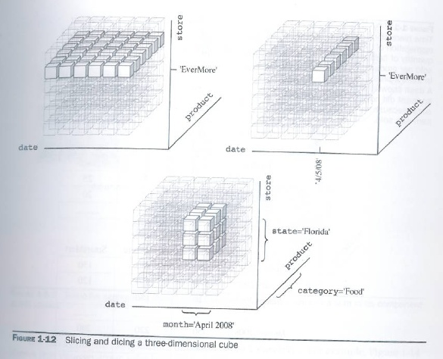
Example: Restriction

Slide 19
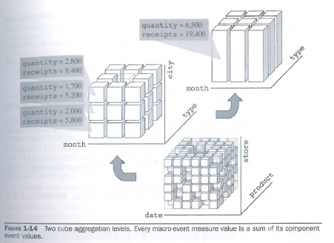
Example: Aggregation

Slide 20
Steps in Requirement Analysis
Existing reports
Reconciled schema
Interview
Identify facts and determine preliminary work load
Identify measures for each fact
Preliminary workload: typical analysis queries
Identify dimensions and levels
dim | fact
 | .. | ..
.. | ✓ | ✓
.. | ✓ | ✓
User requirement glossary: facts, measures, dimensions

Slide 21
Identifying Facts
Facts usually refer to business processes that the users want to measure
Events described by facts should make reference to a time frame (usually there is a time-related dimension)
Application Field | Data Mart | Facts
Manufacturing | Supplies | Purchases, stock inventory, distribution
 | Production | Packaging, inventory, delivery, manufacturing
Finance | Banks | Checking accounts, bank transfers, mortgage loans, loans
 | Investments | Securities, stock exchange transaction
 | Services | Credit cards, bill payment
Health service | Division | Admissions, discharges, transfers, surgical operations, diagnosis, prescriptions
 | Accident & emergency | Admissions, tests, discharges
Management | Human resources | Hiring, resignation, firing, transfers

Slide 22
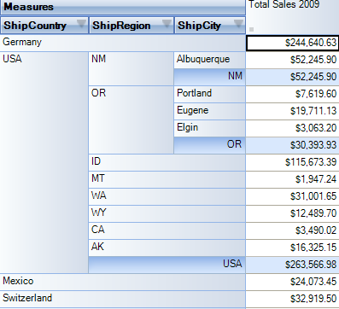
Reports
We can decide facts, dimensions and measures by examining existing reports
Numerical data in the report are measures
Axes / headers are dimensions to sort out data
Date (level year) is a dimension for selecting data.
Ship location is a dimension to sort out data. Its levels include ShipCountry, ShipRegion and ShipCity.
Fact is Sales.
Measure is sales amount in dollars
Notes:
http://www.filebuzz.com/software_screenshot/full/201390-OLAP_Statistics_and_Reporting_for_Access.png

Slide 23
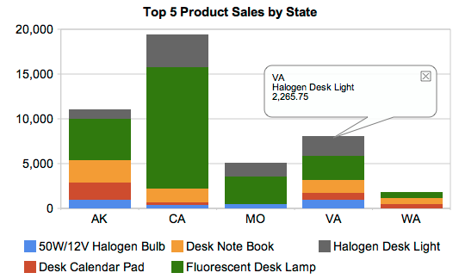
Exercise: Reports with Charts
This report shows the top 5 product sales in a large grocery chain. The y-axis shows the sales amount in dollar, and the x-axis is the location (state) of the stores.
Fact is Sales
Measure is sales amount
in dollars
Dimensions are … ?
Their levels are … ?
Notes:
http://itmarketstrategy.com/2010/02/16/want-broader-bi
http://www.dashboardinsight.com/dashboards/screenshots/pentaho_enterprise_executive_sales_dashboard.aspx
-usage-crystal-founders-offer-indicee/

Slide 24
Preliminary Workload
Collect a set of users' specifications on analysis queries that is going to be issued to the data mart frequently.
through interview and examination of existing reports
Facts | Query
Stock inventory | What is the average quantity of each product made available monthly in every warehouse? Which product stocks ran out at least once last week at the same time in every warehouse? What's the daily trend of all the stocks grouped by product type?
Sales | What's the total amount per product sold last month? What are the daily receipts per store? What are the receipts per product category of a specific store on a specific day? What is the annual report of receipts per city per product?
Order lines | What's the total amount of goods ordered from a specific supplier every year? What's the daily total amount ordered last month for a specific product type? What's the best discount given by each supplier last year and grouped by product category?
Case: A national supermarket chain.

Slide 25
Identifying Measures
Refer to preliminary workload for data required for analysis
Refer to the reconciled layer for available data on the facts
May need to summarize some data in case of different granularity
E.g. the operational data may keep data about each transaction from Point-of-sales. If the data mart only keeps daily receipts, then the receipts measure has to be aggregated from the operational database.
Note: 'receipts' refers to the sales amount in dollar

Slide 26
Identifying the Measures
Facts | Query | Measures
Stock inventory | What is the average quantity of each product made available monthly in every warehouse? Which product stocks ran out at least once last week at the same time in every warehouse? What's the daily trend of all the stocks grouped by product type? | Stocked quantity
Sales | What's the total amount per product sold last month? What are the daily receipts per store? What are the receipts per product category of a specific store on a specific day? What is the annual report of receipts per city per product? | Sold quantity, receipts
Order lines | What's the total amount of goods ordered from a specific supplier every year? What's the daily total amount ordered last month for a specific product type? What's the best discount given by each supplier last year and grouped by product category? | Ordered quantity, discount

Slide 27
Identifying Dimensions
To identify dimensions for a fact, notice what are used to
select data for analysis
group data for aggregation
In the data mart bus architecture, facts should share the same set of dimensions
Known as conformed dimensions
This allows joining two cubes in OLAP queries
The levels of a dimension must satisfy queries about facts that share the dimension

Slide 28
Identifying the Dimensions (1)
Facts | Query
Stock inventory | What is the average quantity made available monthly in every warehouse? Which product stocks ran out at least once last week at the same time in every warehouse? What's the daily trend of all the stocks grouped by product type?
Sales | What's the total amount per product sold last month? What are the daily receipts per store? What are the receipts per product category of a specific store on a specific day? What is the annual report of receipts per city per product?
Order lines | What's the total amount of goods ordered from a specific supplier every year? What's the daily total amount ordered last month for a specific product type? What's the best discount given by each supplier last year and grouped by product category?
Each fact typically has a time dimension (Date)
Check the granularity of Date in selecting and sorting out the facts. This determines the hierarchy levels
Date levels: day, week, month, year
Finest granularity: one day

Slide 29
Identifying the Dimensions (2)
Facts | Query
Stock inventory | What is the average quantity made available monthly in every warehouse? Which product stocks ran out at least once last week at the same time in every warehouse? What's the daily trend of all the stocks grouped by product type?
Sales | What's the total amount per product sold last month? What are the daily receipts per store? What are the receipts per product category of a specific store on a specific day? What is the annual report of receipts per city per product?
Order lines | What's the total amount of goods ordered from a specific supplier every year? What's the daily total amount ordered last month for a specific product type? What's the best discount given by each supplier last year and grouped by product category?
The three facts also share the Product dimension
Check the granularity to determine the hierarchy levels
Product levels: product, type, category
Finest granularity: individual product

Slide 30
Identifying the Dimensions (3)
Facts | Query
Stock inventory | What is the average quantity made available monthly in every warehouse? Which product stocks ran out at least once last week at the same time in every warehouse? What's the daily trend of all the stocks grouped by product type?
Sales | What's the total amount per product sold last month? What are the daily receipts per store? What are the receipts per product category of a specific store on a specific day? What is the annual report of receipts per city per product?
Order lines | What's the total amount of goods ordered from a specific supplier every year? What's the daily total amount ordered last month for a specific product type? What's the best discount given by each supplier last year and grouped by product category?
One more dimension for each fact:
Dimension warehouse, levels: warehouse
Dimension store, levels: store, city
Dimension supplier, levels: supplier
No hints for levels for some dimensions
Assume finest granularity (e.g. individual warehouse and supplier)
May add some levels by using attributes in source data about the facts (e.g. location of a warehouse, and supplier)

Slide 31
Dimensions and Levels
Facts | Query
Stock inventory | What is the average quantity made available monthly in every warehouse? Which product stocks ran out at least once last week at the same time in every warehouse? What's the daily trend of all the stocks grouped by product type?
Sales | What's the total amount per product sold last month? What are the daily receipts per store? What are the receipts per product category of a specific store on a specific day? What is the annual report of receipts per city per product?
Order lines | What's the total amount of goods ordered from a specific supplier every year? What's the daily total amount ordered last month for a specific product type? What's the best discount given by each supplier last year and grouped by product category?
Dimensions | Levels in hierarchy
Date | day, week, month, year, …
Product | product, type, category, …
Warehouse | warehouse, …
Store | store, city, …
Supplier | supplier,

Slide 32
User Requirement Glossary
Fact | Measures | Dimensions
Stock inventory | stocked quantity | product, date, warehouse
Sales | sold quantity, receipts, discount | product, date, store
Order lines | ordered quantity, discount | product, date, supplier
Dimension | Levels in hierarchy
Date | day, week, month, year
Product | product, type, category
Warehouse | warehouse
Store | store, city
Supplier | supplier

Slide 33
Matrix Forms
Dimensions | Facts
 | Stock Inventory | Sales | Order lines
Date | ✓ | ✓ | ✓
Product | ✓ | ✓ | ✓
Warehouse | ✓
Store |  | ✓
Supplier |  |  | ✓
Dimension | Levels
Date | day, week, month, year
Product | product, type, category
Warehouse | warehouse
Store | store, city
Supplier | supplier
Fact | Measures
Stock inventory | stocked quantity
Sales | sold quantity, receipts, discount
Order lines | ordered quantity, discount

Slide 34
Review questions
What are the essential differences between defining requirements for operational systems and for data warehouses?
What are some difficulties in capturing user requirements in data mart design?
Use an example to explain the multidimensional model.
List some dimensions for fact(s) related to academic performance of university students.

